Slide 1
NLP in recommendation Engine
Group Project
Name | Roll no.
Vishal Kashyap | 25
Akshay Oza | 40

Slide 2
1 - Introduction
2 - Problem Statement
3 - Data and Preprocessing

Slide 3
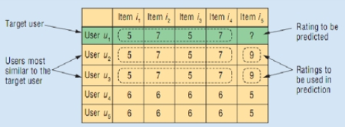
Graphical represenation of Problem statement.

Slide 4
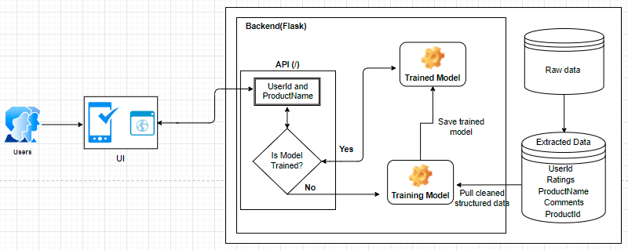
Architecture

Slide 5
Algorithm - SVD

